Slide 1
CMSC204
Kartchner
V(StateGraph) = {Oregon, Alaska, Texas, Hawaii, Vermont, NewYork, California}
E(StateGraph) = {(Alaska, Oregon), (Hawaii, Alaska), (Hawaii, Texas), (Texas, Hawaii), (Hawaii, California), (Hawaii, New York), (Texas, Vermont), (Vermont, California), (Vermont, Alaska)}
1. Draw the StateGraph
Oregon
Alaska
Texas
Hawaii
New York
Vermont
California

Slide 2
a. Show the adjacency matrix that would describe the edges in the graph. Store the vertices in alphabetical order
States
AL CA HI NY OR TX VT
Alaska
California
Hawaii
New York
Oregon
Texas
Vermont
0 0 0 0 1 0 0
0 0 0 0 0 0 0
1 1 0 1 0 1 0
0 0 0 0 0 0 0
0 0 0 0 0 0 0
0 0 1 0 0 0 1
1 1 0 0 0 0 0
3. b. Show the adjacency lists
that would describe the edges in the graph
Alaska: [Oregon]
California: []
Hawaii: [Alaska, California, New York, Texas]
New York: []
Oregon: []
Texas: [Hawaii, Vermont]
Vermont: [Alaska, California]

Slide 3
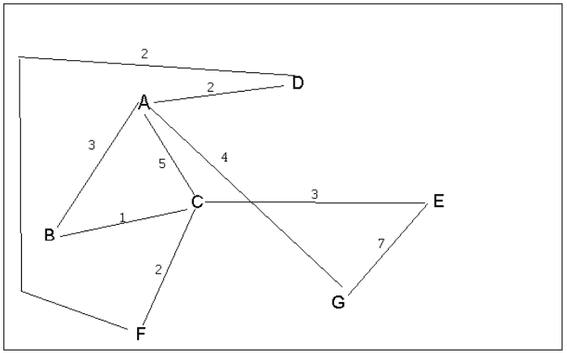
4 a. Which of the following lists the graph nodes in depth first order beginning with E?
A) E, G, F, C, D, B, A
B) G, A, E, C, B, F, D
C) E, G, A, D, F, C, B
D) E, C, F, B, A, D, G
4 b. Which of the following lists the graph nodes in breadth first order beginning at F?
A) F, C, D, A, B, E, G
B) F, D, C, A, B, C, G
C) F, C, D, B, G, A, E
D) a, b, and c are all breadth first traversals

Slide 4
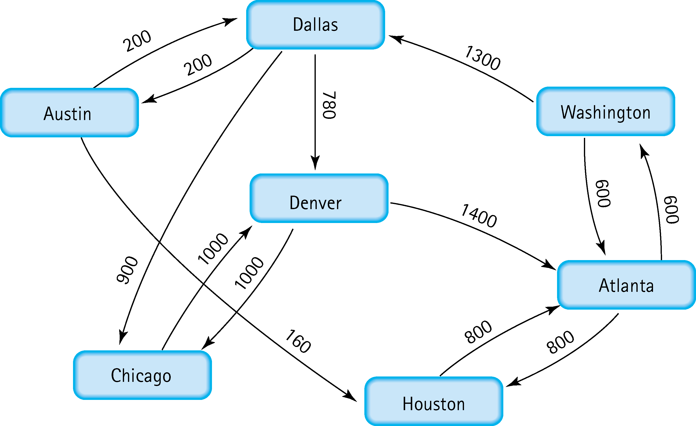
5. Find the shortest distance from Atlanta to every other city
From Atlanta to:
Houston: 800
Washington: 600
Denver: 2680
Dallas: 1900
Austin: 2100
Chicago: 2800

Slide 5
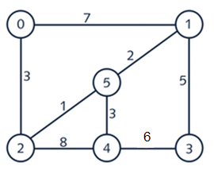
6. Find the minimal spanning tree using Prim’s algorithm. Use
0 as the source vertex . Show the steps.
(0,2) weight 3
(2,5) weight 1
(5,1) weight 2
(5,4) weight 3
(1,3) weight 5

Slide 6
7. Find the minimal spanning tree using Kruskal’s algorithm.
Show the weights in order and the steps.
(2,5) weight 1
(5,1) weight 2
(5,4) weight 3
(2,0) weight 3
(1,3) weight 5

Slide 7
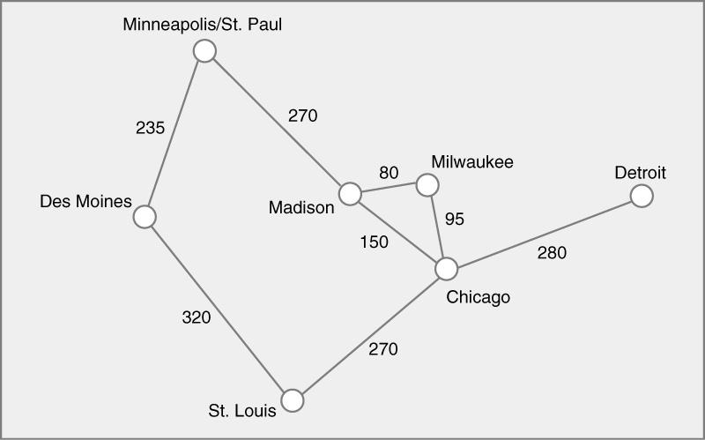
8. Find the minimal spanning tree using the algorithm you prefer. Use
Minneapolis/St. Paul as the source vertex
{Minneapolis, Des Moines} weight 235
{Minneapolis, Madison} weight 270
{(Madison, Milwaukee} weight 80
{Milwaukee, Chicago} weight 95
{Chicago, St. Louis} weight 270
{Chicago, Detroit} weight 280

Slide 8
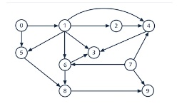
9. List the nodes of the graph in a breadth first topological ordering. Show the
steps using arrays predCount, topologicalOrder and a queue
predCount:
0: 0, 1: 1, 2: 1, 3: 3, 4: 3, 5: 2, 6: 2, 7: 0, 8: 2, 9: 2
1: 0, 2: 1, 3: 3, 4: 3, 5: 1, 6: 2, 7: 0, 8: 2, 9: 2
1: 0, 2: 1, 3: 3, 4: 2, 5: 1, 6: 1, 8: 2, 9: 1
2: 0, 3: 2, 4: 1, 5: 0, 6: 0, 8: 2, 9: 1
3: 2, 4: 0, 5: 0, 6: 0, 8: 2, 9: 1
3: 2, 4: 0, 6: 0, 8: 1, 9: 1
3: 1, 4: 0, 8: 0, 9: 1
3: 0, 8: 0, 9: 1
3: 0, 9: 0
9: 0
Queue: [0, 7]. Dequeue 0. topologicalOrder: [0].
Queue: [7, 1]. Dequeue 7. topologicalOrder: [0, 7].
Queue: [1]. Dequeue 1. topologicalOrder: [0, 7, 1].
Queue: [2, 5, 6]. Dequeue 2. topologicalOrder: [0, 7, 1, 2].
Queue: [5, 6, 4]. Dequeue 5. topologicalOrder: [0, 7, 1, 2, 5].
Queue: [6, 4]. Dequeue 6. topologicalOrder: [0, 7, 1, 2, 5, 6].
Queue: [4, 8]. Dequeue 4. topologicalOrder: [0, 7, 1, 2, 5, 6, 4].
Queue: [8, 3]. Dequeue 8. topologicalOrder: [0, 7, 1, 2, 5, 6, 4, 8].
Queue: [3, 9]. Dequeue 3. topologicalOrder: [0, 7, 1, 2, 5, 6, 4, 8, 3].
Queue: [9]. Dequeue 9. topologicalOrder: [0, 7, 1, 2, 5, 6, 4, 8, 3, 9].

Slide 9
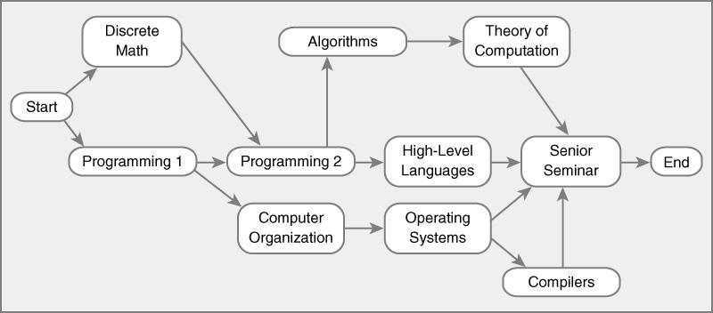
10. List the nodes of the graph in a breadth first topological ordering.
predCount:
Start:0, DM:1, P1:1, P2:2, CO:1, A:1, HLL:1, OS:1, SS:4, C: 1, TOC:1, End:1
DM:0, P1:0, P2:2, CO:1, A:1, HLL:1, OS:1, SS:4, C: 1, TOC:1, End:1
P1:0, P2:1, CO:1, A:1, HLL:1, OS:1, SS:4, C: 1, TOC:1, End:1
P2:0, CO:0, A:1, HLL:1, OS:1, SS:4, C: 1, TOC:1, End:1
CO:0, A:0, HLL:0, OS:1, SS:4, C: 1, TOC:1, End:1
A:0, HLL:0, OS:0, SS:4, C: 1, TOC:1, End:1
HLL:0, OS:0, SS:4, C: 1, TOC:0, End:1
OS:0, SS:3, C: 1, TOC:0, End:1
SS:2, C: 0, TOC:0, End:1
SS:1, C: 0, End:1
SS:0, End:1
End:0
Queue: [Start]. Dequeue Start. topologicalOrder: [Start].
Queue: [DM, P1]. Dequeue DM. topologicalOrder: [Start, DM].
Queue: [P1]. Dequeue P1. topologicalOrder: [Start, DM, P1].
Queue: [P2, CO]. Dequeue P2. topologicalOrder: [Start, DM, P1, P2].
Queue: [CO, A, HLL]. Dequeue CO. topologicalOrder: [Start, DM, P1, P2, CO].
Queue: [A, HLL, OS]. Dequeue A. topologicalOrder: [Start, DM, P1, P2, CO, A].
Queue: [HLL, OS, TOC]. Dequeue HLL. topologicalOrder: [Start, DM, P1, P2, CO, A, HLL].
Queue: [OS, TOC]. Dequeue OS. topologicalOrder: [Start, DM, P1, P2, CO, A, HLL, OS].
Queue: [TOC, C]. Dequeue TOC. topologicalOrder: [Start, DM, P1, P2, CO, A, HLL, OS, TOC].
Queue: [C]. Dequeue C. topologicalOrder: [Start, DM, P1, P2, CO, A, HLL, OS, TOC, C].
Queue: [SS]. Dequeue SS. topologicalOrder: [Start, DM, P1, P2, CO, A, HLL, OS, TOC, C, SS].
Queue: [End]. Dequeue End. topologicalOrder: [Start, DM, P1, P2, CO, A, HLL, OS, TOC, C, SS, End].

